Slide 1

Window title
Loading …

Slide 2

Window title
Made in Unity
Made in Unity

Slide 3

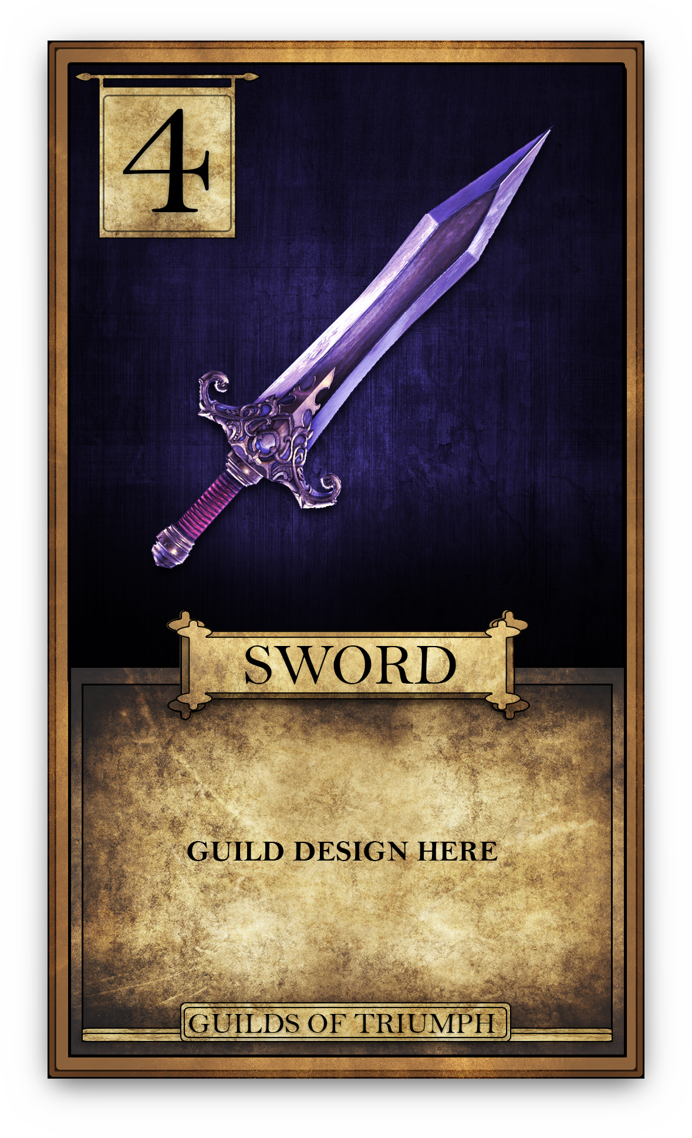

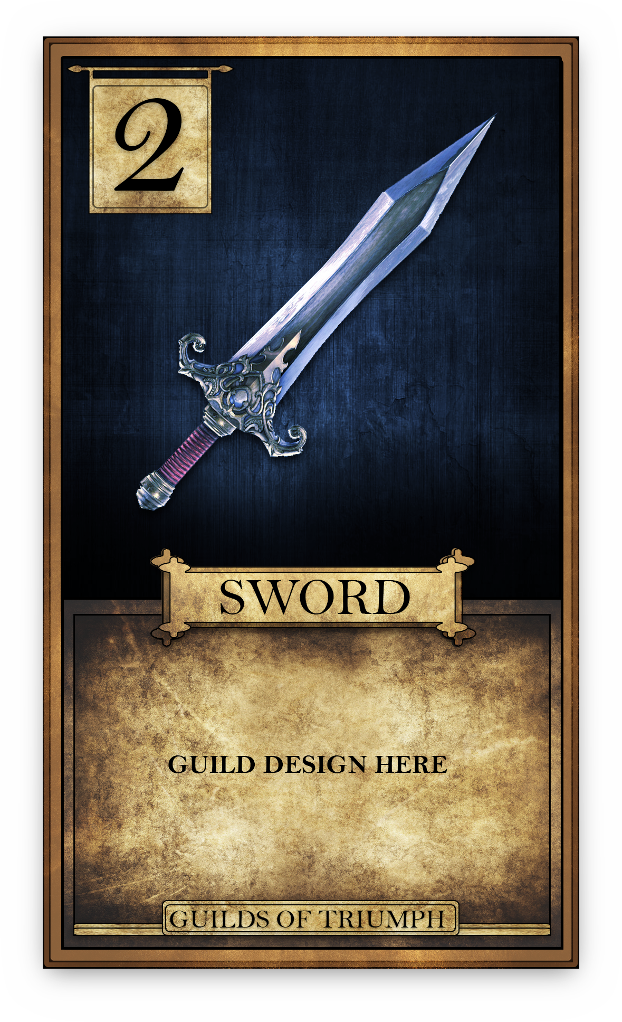
Main Menu
Guilds of Triumph
Singleplayer
Multiplayer
Help
Settings
Exit

Slide 4
Window title
Loading …

Slide 5
Multiplayer
Window title
Singleplayer configuration
Singleplayer configuration
Guilds of Triumph
Play
Exit

Slide 6
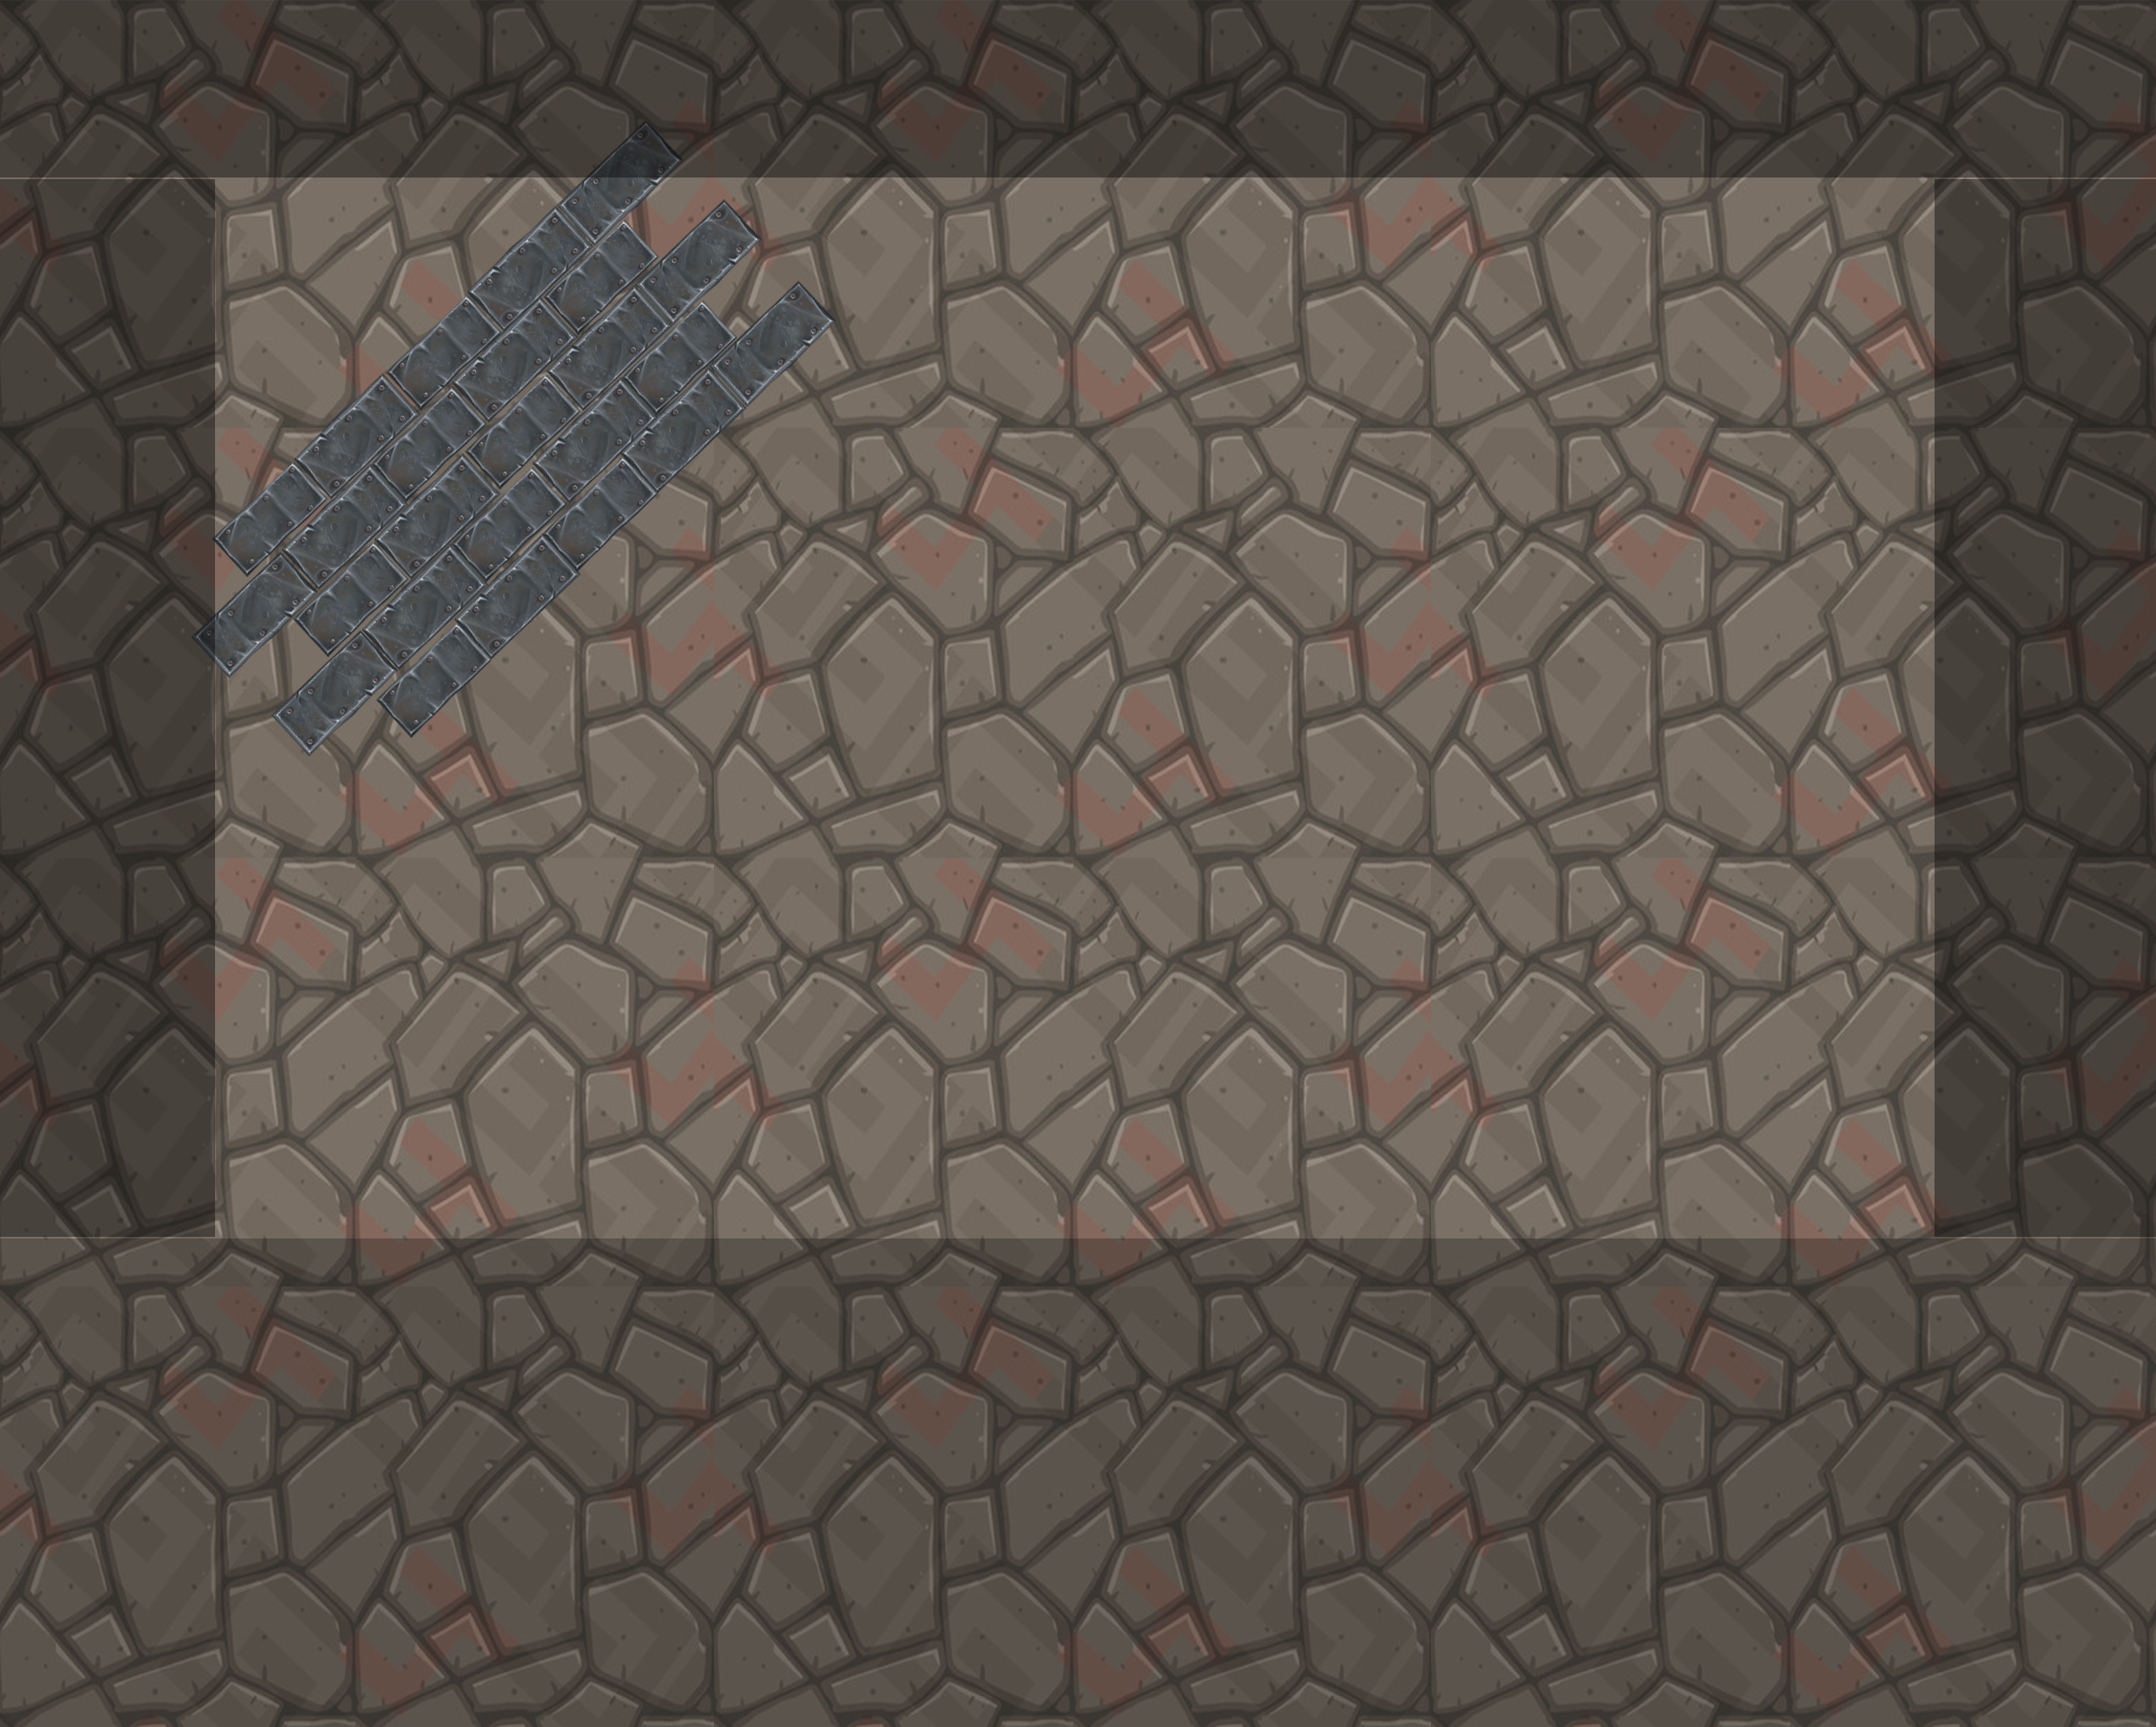
Singleplayer
Singleplayer
Settings
Pick card
End turn
Exit

Slide 7
Window title
Loading …

Slide 8
Multiplayer
Window title
Multiplayer configuration
Multiplayer configuration
Guilds of Triumph
Play
Exit

Slide 9
Multiplayer
Window title
Multiplayer
Multiplayer
Settings
Pick card
End turn
Exit

Slide 10
Window title
Loading …

Slide 11
Multiplayer
Window title
Help
Help
Guilds of Triumph
Back to Main Menu

Slide 12
Window title
Loading …

Slide 13
Multiplayer
Window title
Settings
Settings
Guilds of Triumph
Back to Main Menu

Slide 14
Window title

